Slide 1
Data Storage Approach
Classify your data as structured, semi-structured, or unstructured
Determine how your data will be used
Determine whether your data requires transactions

Slide 2
Classify Your Data
Structured data
Semi-structured data
XML
JSON
YAML
Unstructured data
Media files, such as photos, videos, and audio files
Office files, such as Word documents
Text files
Log files
Azure Functions is the newest service in the serverless architecture family

Slide 3
Scenario
Flipkart - An online retailer you know customers need quick access to product data, and business users need to run complex analytical queries.
Product catalog data
query the product catalog
customers place orders
Photos and videos
photos and videos that are displayed on product pages
Business data
business data is read-only
having some latency in the results is okay

Slide 4
What is a transaction?
A transaction is a logical group of database operations that execute together.
Product catalog data
transactional database
Photos and videos
don't require transactional support.
Business data
data is historical and unchanging, transactional support is not required

Slide 5
Product catalog data
Azure Cosmos DB
supports semi-structured data
supports SQL for queries and every property is indexed by default
ACID-compliant
enables you to replicate your data anywhere in the world

Slide 6
Why not other Azure services?
Azure SQL Database
combine structured data in the columns, and semi-structured data stored as JSON columns that can be easily extended
Unlike Azure CosmosDB that index every property in the documents, in Azure SQL Database you need to explicitly define what properties from semi-structured documents should be indexed.
Azure Cosmos DB is better choice for highly unstructured and variable data where you cannot predict what are the properties that should be indexed.

Slide 7
Photos and videos
Azure Blob storage
move images from the hot storage tier to the cool or archive storage tier, to reduce costs and focus throughput on the most frequently viewed images and videos
Why not other Azure services?
You could upload your images to Azure App Service, so that the same server that is running your app is serving up your images. This solution would work if you didn't have many files. But if you have lots of files, and a global audience, you'll get more performance results by using Azure Blob storage with Azure CDN.

Slide 8
Business data
Read-only, complex analytical queries across multiple databases
Azure SQL Database
Azure Stream Analytics - focus is on real-time data
Azure Synapse supports - OLAP solutions and SQL queries
Azure Analysis Services -tabular data stored on the service itself, but not multidimensional data.

Slide 9
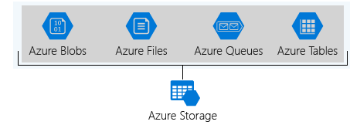
Storage Account
What is Azure Storage?
A storage account is a container that groups a set of Azure Storage services together
Azure data services like Azure SQL and Azure Cosmos DB are managed as independent Azure resources and cannot be included in a storage account.

Slide 10
Storage account settings
specify that all the contained services will be stored in the West US datacenter, accessible only over https, and billed to the sales department's subscription.
Standard allows you to have any data service (Blob, File, Queue, Table) and uses magnetic disk drives
Premium introduces additional services for storing data
Access tier
Hot
Cold
Archieve

Slide 11
How many storage accounts do you need?
storage account represents a collection of settings like location, replication strategy, and subscription owner.
Data diversity
Cost sensitivity
storage account by itself has no financial cost

Slide 12
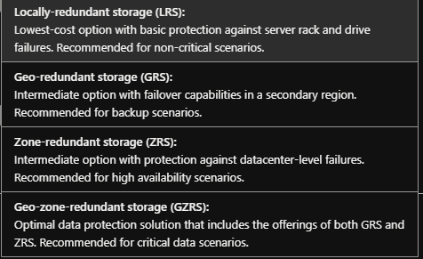
Redundancy

Slide 13
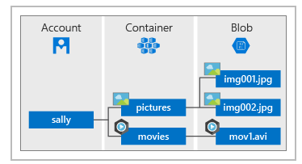
Azure Blob Storage
Azure Blob Storage is unstructured, meaning that there are no restrictions on the kinds of data it can hold.
Azure Blob Storage is an object storage solution for the cloud.
One advantage of blob storage over disk storage is that it does not require developers to think about or manage disks; data is uploaded as blobs, and Azure takes care of the physical storage needs.

Slide 14
Azure Files
Azure Files offers fully managed file shares in the cloud that are accessible via the industry standard Server Message Block and Network File System (preview) protocols.
Azure Files makes it easier to migrate those applications that share data to Azure.
Store configuration files on a file share and access them from multiple VMs.

Slide 15
Understanding Blob access tiers
Hot access tier: Optimized for storing data that is accessed frequently (for example, images for your website).
Cool access tier: Optimized for data that is infrequently accessed and stored for at least 30 days (for example, invoices for your customers).
Archive access tier: Appropriate for data that is rarely accessed and stored for at least 180 days, with flexible latency requirements (for example, long-term backups).

